Slide 1


Unit 1: Culture spot 1 How much do you know about the UK

Slide 2
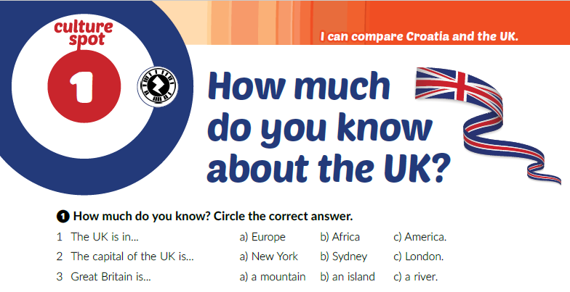

Slide 3
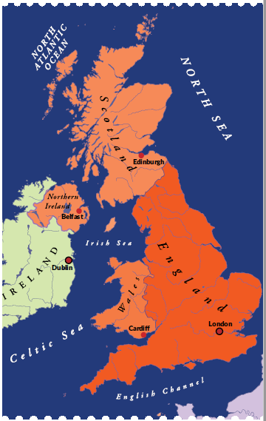
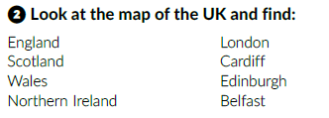

Slide 4
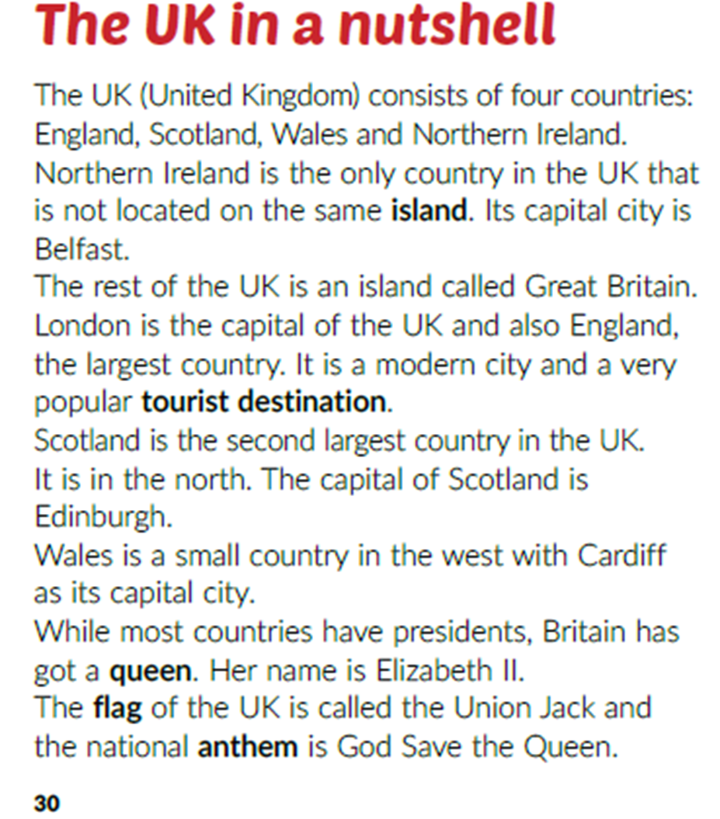
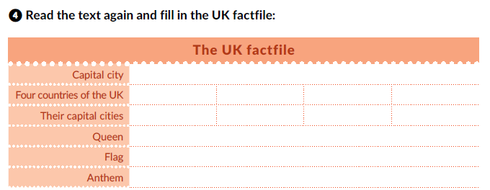
London
England
Scotland
Wales
Northern Ireland
London
Edinburgh
Cardiff
Belfast
Elizabeth II (But now the king is her son Charles III.)
Union Jack
God Save the Queen (But now the anthem is God Save the King.)

Slide 5
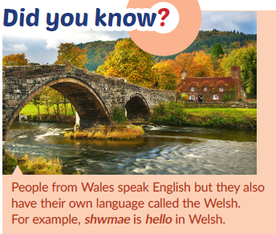
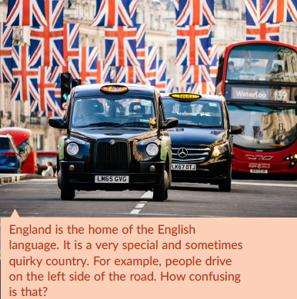
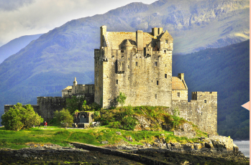


Slide 6



Slide 7
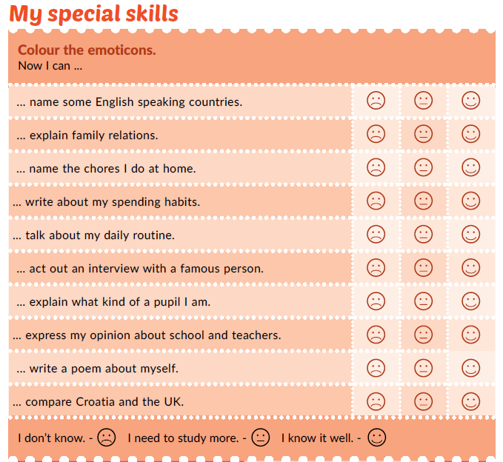

Slide 8
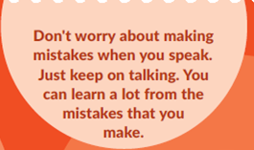

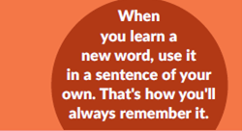

Slide 9

PLAY AND LEARN
https://www.e-sfera.hr/dodatni-digitalni-sadrzaji/f27781d0-2f1d-458e-b908-313ff0156d6a/

